Slide 1
ORM Introduction
Continuous staff improvement project
Yurii Hohan

Slide 2
Introduction
ORM.
What problems does it solve?
Examples of impedance mismatch.
Entity.
Entity framework

Slide 3
What is ORM
Object-relational mapping (ORM, O/RM, and O/R mapping) in computer science is a programming technique for converting data between incompatible type systems in object-oriented programming languages.
The object-relational impedance mismatch is a set of conceptual and technical difficulties that are often encountered when a relational database management system (RDBMS) is being used by a program written in an object-oriented programming language or style, particularly when objects or class definitions are mapped in a straightforward way to database tables or relational schema.

Slide 4
What is Persistence
Let’s say you want to create an application that lets users store their company telephone numbers and contact details, and retrieve them whenever needed. Unless you want the user to leave the program running all the time, you’ll soon realize that your application needs to somehow save the contacts somewhere.
You’re faced with a persistence decision: you need to work out which persistence mechanism you want to use.
You have the option of persisting your data in many places, the simplest being a text file. More often than not, you may choose a relational database, because such databases are widely understood and offer great features for reliably storing and retrieving data.
The approach we take is to write classes—or business entities—that can be loaded to and saved from the database. Such classes typically represent the object-oriented domain model.

Slide 5
What is Entity
An object of entity type has its own database identity (primary-key value). An object reference to an entity is persisted as a reference in the database (a foreign-key value). An entity has its own lifecycle; it may exist independently of any other entity.
The identity of a database row is commonly expressed as the primary key value. With relational databases, it’s recommended that you use a surrogate key—a primary key column with no meaning to the user.

Slide 6
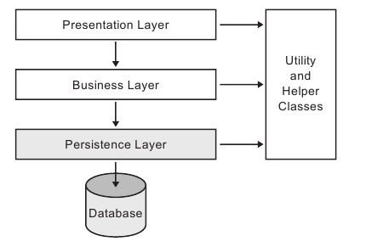
Layered Architecture

Slide 7
Approaches to persistence in .NET
Hand coding
DataSets
LINQ-to-SQL
NHibernate (or similar)
ADO.NET
Entity Framework

Slide 8
What problems does it solve?
Any changes to domain model are reflected in database. Refactoring is much easier due to avoiding of magic strings.
You do not have to write a lot of plumbing code and re-invent the wheel.
Versioning of changes.
Allows to migrate database from one relational engine to another relatively easy.
Disadvantages:
Performance due to magic strings and non-optimal plumbing code.
Sometimes it is difficult to get ORM to generate the exact SQL you need.
Makes you use more of standard SQL which keeps you from using vendor-specific functionality.

Slide 9
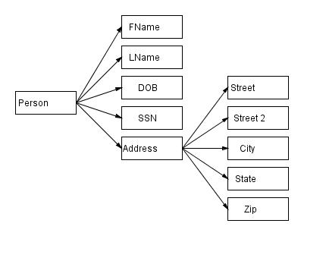
Object graph
A Person has simple fields like FName and LName and a list of Address.
Address also has a reference to a Person.
The relation is bi-directional

Slide 10
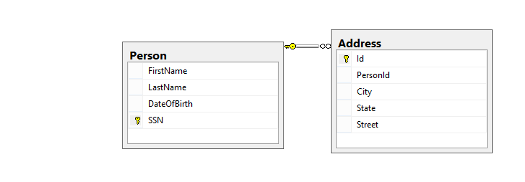
Uniderectional in Db
Only Address has a reference to a Person and not vice versa.
Changes from two places in memory of object graph have to be applied in data base only once.

Slide 11
Impedance mismatch
Two-way bidirectional relationship in object graphs and foreign keys in SQL server.
Inheritance in objects and mapping hierarchies in database.
OO itterative approach in C# and set-base approach in SQL code.
DB cascades vs ORM cascading.

Slide 12
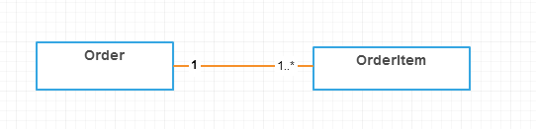
Versioning Example
User A opens an order containing order item 1 and 2
User B opens an order containing order item 1 and 2
User A removes order item 1 and 3
At the same time user B removes order item 2 and 4
They both refresh.
They get 3,4 and cannot understand what happened.
Data stality – changing order should increment its version and one should save something if the entity of local copy is different from one on the server.

Slide 13
Entity framework

Slide 14
Entity Framework
Entity Data Model
Conceptual Model - EF builds the conceptual model from your domain classes, context class, default conventions followed in your domain classes, and configurations.
Mapping - EF includes mapping information on how the conceptual model maps to the database schema (storage model).
Storage model - EF builds the storage model for the underlying database schema. In the code-first approach, this will be inferred from the conceptual model. In the database-first approach, this will be inferred from the targeted database
DbContext
Implements unit of work pattern
Keeps track of everything you do during a business transaction that can affect the database. When you're done, it figures out everything that needs to be done to alter the database as a result of your work.

Slide 15
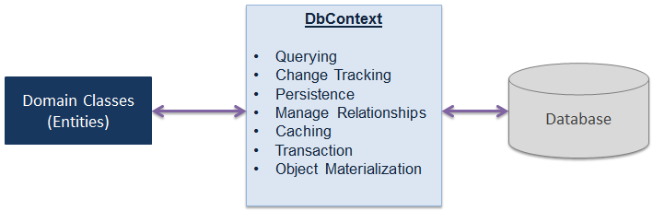
DbContext
To access a database in any way via EF you need to define an application
DbContext.
An EF query consists of three parts: The application’s DbContext property, a series of LINQ/EF commands and finally a command to execute the query.

Slide 16
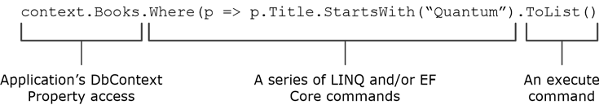
DbContext

Slide 17
DbContext

Slide 18
DbContext
public class SchoolContext : DbContext
{
public SchoolContext() : base("SchoolContext")
{ }
public DbSet<Student> Students { get; set; }
public DbSet<Course> Courses { get; set; }
}
The DbSet class represents an entity set that can be used for create, read, update, and delete operations.

Slide 19
DbContext METHODS
Method | Usage
Entry | Gets an DbEntityEntry for the given entity. The entry provides access to change tracking information and operations for the entity.
SaveChanges | Executes INSERT, UPDATE and DELETE commands to the database for the entities with Added, Modified and Deleted state.
SaveChangesAsync | Asynchronous method of SaveChanges()
Set | Creates a DbSet<TEntity> that can be used to query and save instances of TEntity.
OnModelCreating | Override this method to further configure the model that was discovered by convention from the entity types exposed in DbSet<TEntity> properties on your derived context.
ChangeTracker | Provides access to information and operations for entity instances that this context is tracking.
Configuration | Provides access to configuration options.
Database | Provides access to database related information and operations.

Slide 20
Connectiong string
public SchoolContext() : base("SchoolContext")
{
}
<connectionStrings>
<add name="SchoolContext" connectionString="Data Source=(LocalDb)\v11.0;Initial Catalog=ContosoUniversity1;Integrated Security=true;" providerName="System.Data.SqlClient"/> </connectionStrings>
name – connection string name
Data source – path to database server
Initial Catalog – database name
Integrated Security=true – use Windows Authentication to access database

Slide 21
Entity STATES
Entity instances that are tracked have a State, which can be Added, Unchanged, Modified, or Deleted. This State define what happens to the entity when SaveChanges is called.
In real-world applications, there are two types of update scenarios, connected and disconnected state, that affect the way you do the update.

Slide 22
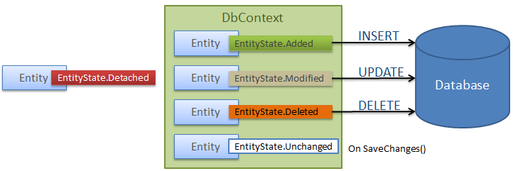
Entity States
Added: The entity does not yet exist in the database. SaveChanges will insert it.
• Unchanged: The entity exists in the database and has not been modified on the client.
SaveChanges will ignore it.
• Modified: The entity exists in the database and has been modified on the client.
SaveChanges will update it.
• Deleted: The entity exists in the database but should be deleted. SaveChanges will
delete it.
• Detached: The entity you provided is not tracked. SaveChanges doesn’t see it.

Slide 23
Entity States

Slide 24
Persistence in Entity Framework
There are two scenarios when persisting (saving) an entity to the database using Entity Framework:
Connected Scenario
Disconnected Scenario.

Slide 25
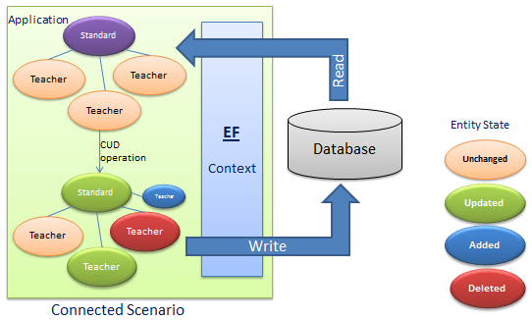
Connected scenario

Slide 26
Connected scenario
In the connected scenario, the same instance of the context class (derived from DbContext) is used in retrieving and saving entities. It keeps track of all entities during its lifetime. This is useful in windows applications with the local database or the database on the same network.
Pros:
Performs fast.
The context keeps track of all entities and automatically sets an appropriate state as and when changes occurr to entities.
Cons:
The context stays alive, so the connection with the database stays open.
Utilizes more resources.

Slide 27
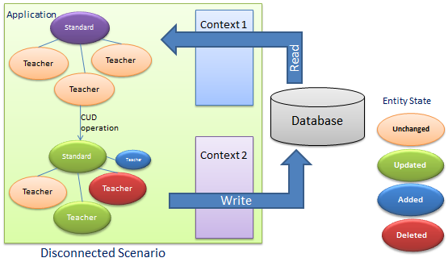
Disconnected Scenario

Slide 28
Disconnected Scenario
The disconnected scenario is complex because an instance of the context doesn't track entities, so you must set an appropriate state to each entity before saving entities using SaveChanges(). The application retrieves an entity graph using Context 1 and then the application performs some CUD (Create, Update, Delete) operations using Context 2. Context 2 doesn't know what operation has been performed on the entity graph in this scenario.
This is useful in web applications or applications with a remote database.
Pros:
Utilizes less resources compared to the connected scenario.
No open connection with the database.
Cons:
Need to set an appropriate state to each entity before saving.
Performs slower than the connected scenario.

Slide 29
Sql – CLR Type mapping
SQL Server and the .NET Framework are based on different type systems. Both SQL Server types and .NET Framework types are also represented by enumerations in the DbType and SqlDbType classes, which you can use when specifying SqlParameter data types.
For example, the .NET Framework Decimal structure has a maximum scale of 28, whereas the SQL Server decimal and numeric data types have a maximum scale of 38.
SQL Server Database Engine type | .NET Framework type
bigint | Int64
binary | Byte[]
bit | Boolean
char | String
 | Char[]
date | DateTime
datetime | DateTime
datetime2 | DateTime
decimal | Decimal
float | Double
int | Int32
money | Decimal
 | Char[]
numeric | Decimal
nvarchar | String
 | Char[]

Slide 30
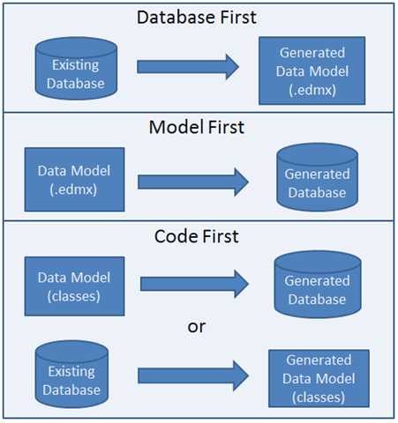
Approaches with EF

Slide 31
Approaches with EF
Code First* - the standard way to create or update a database schema is by using your entity classes and the application’s DbContext as the template for your database.
Database-First* - EF Core has a command that inspects an existing database and creates the various entity classes and the application’s DbContext to match that database
Model First* - Model First allows you to create a new model using the Entity Framework Designer and then generate a database schema from the model. The model is stored in an EDMX file (.edmx extension) and can be viewed and edited in the Entity Framework Designer. The classes that you interact with in your application are automatically generated from the EDMX file.
* - hyperlink available

Slide 32
Approaches with EF
Visual studio Demo

Slide 33
Assignment
Study and read about all mentioned concepts.
Configure Entity Framework.
Create repository projects.
Map your first Entity in the application.

